Slide 1
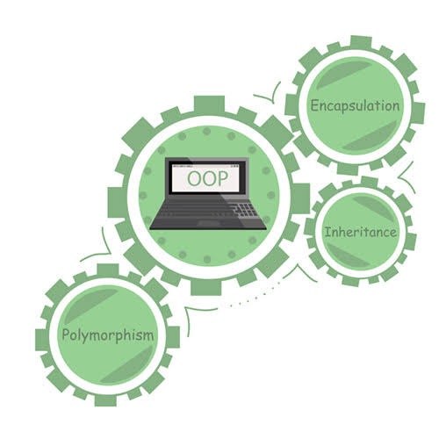

Database Management System
Topic: UML
Dr. Chandralekha M
Asst. Prof. CSE
Amrita School of Engineering
| Chennai Campus

Slide 2

Contents
UML
Class Diagram
Activity Diagram
Deployment Diagram
Use Case Diagram

Slide 3
UML – Unified Modeling Language
Provides a standard notation that can be used by all object-oriented methods and to select and integrate the best elements of precursor notations.
Provide users with a ready-to-use, expressive visual modeling language so they can develop and exchange meaningful models.
Be independent of particular programming languages and development processes.

Slide 4
Why many types of UML diagrams?
UML
Analysts
Designers
Coders
Testers
The Customer
Technical Authors
All of these people are interested in different aspects of the system, and each of them require a different level of detail.
A coder needs to understand the design of the system and be able to convert the design to a low-level code.
By contrast, a technical writer is interested in the behavior of the system as a whole and needs to understand how the product functions.

Slide 5
UML
It is an industry standard graphical language for specifying, visualizing, constructing and documenting the artifacts of software systems.
Combines techniques from : data modelling, business modelling, object modelling, and component modelling.
UML diagram represents two different views of system model:
Static model or Structural view
Dynamic model or Behavioural view

Slide 6
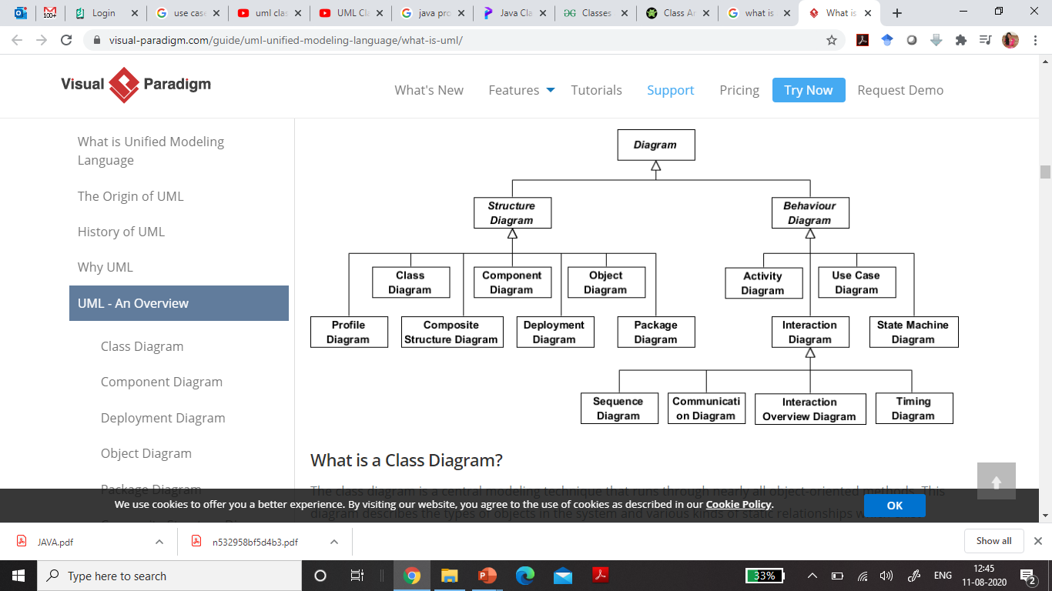
UML Diagram
The static structure of the system and its parts on different abstraction and implementation levels and how they are related to each other
Show the dynamic behavior of the objects in a system, which can be described as a series of changes to the system over time
Deployment Diagram
Class Diagram
Use case Diagram
Activity Diagram

Slide 7
UML Diagram

Slide 8
Class Diagram
A central modeling technique that runs through nearly all object-oriented methods.
This diagram describes the types of objects in the system and various kinds of static relationships which exist between them.
Relationships:
Association - represent relationships between instances of types (a person works for a company, a company has a number of offices.
Inheritance - the most obvious addition to ER diagrams for use in OO. It has an immediate correspondence to inheritance in OO design.
Aggregation - Aggregation, a form of object composition in object-oriented design.

Slide 9
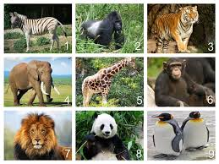
Zoo system
Animal
Class name
-name : string
-id : int
-age : int
Name, Id, Age
Attributes
Visibility followed by lower case letters
-setName()
-eat()
Methods
Arguments not necessary
Instances of Animal Class

Slide 10
Zoo system
Visibility
Animal
Class name
- private
- name : string
-id : int
#age : int
+ public
Attributes
+setName()
+eat()
# protected
Methods
~ package/ default

Slide 11
Employee - class
Private Attributes: Name (String), employee id (integer), phone ( string), department (string).
Protected Attributes: Salary (double), dateofBirth(String)
Public Methods: updatePhone(), CalculateInterest()
Employee
-name : string
-id: int
-phone: string
-department: string
#salary: double
#dateofBirth: string
+updatePhone()
+calculateInterest()

Slide 12
Relationships
Animal
Superclass
- name : string
-id : int
#age : int
Inheritance
+setName()
+eat()
Subclasses
Subclass inherits all attributes from superclass.
Tortoise
Rabbit
Lion
-length : int

Slide 13
Relationships
Abstract Class
Animal
Class name in italics.
- name : string
-id : int
#age : int
Inheritance
+setName()
+eat()
Subclasses
Subclass inherits all attributes from superclass.
Tortoise
Rabbit
Lion
-length : int

Slide 14
Relationships
Animal
- name : string
-id : int
#age : int
Association
+setName()
+eat()
Tortoise
Rabbit
-length : int
Carrot
eats

Slide 15
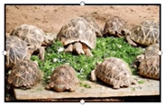
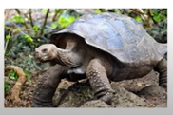
Relationships
Animal
- name : string
-id : int
#age : int
Aggregation
+setName()
+eat()
A relationship which can exist outside the hope.
Aggregation
Creep
Tortoise
Rabbit
-length : int
Aggregation
A tortoise could be in Creep or it can still exist by itself.

Slide 16
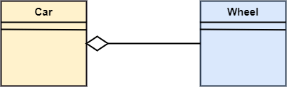
Here we are considering a car and a wheel example.
A car cannot move without a wheel.
But the wheel can be independently used with the bike, scooter, cycle, or any other vehicle.
The wheel object can exist without the car object, which proves to be an aggregation relationship.

Slide 17
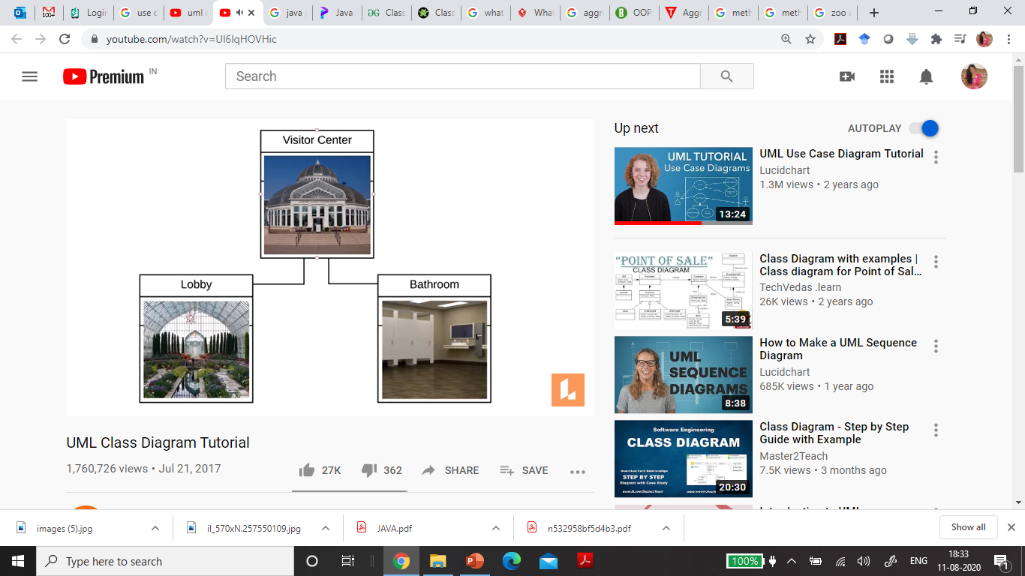
Relationships
Composition
A relationship that cannot exist outside the hope.
Each visitor center has one lobby and one bathroom.

Slide 18
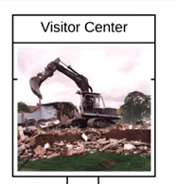
Relationships
Composition
A relationship that cannot exist outside the hope.
Composition
Each visitor center has one lobby and one bathroom.
When Visitor center gets destroyed, Lobby and Bathroom also will not exist.
When a child object would not be able to exist without its parent object.

Slide 19
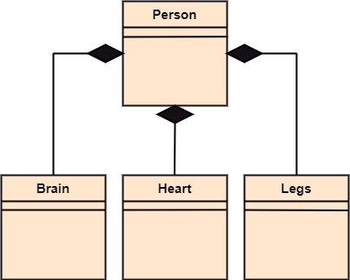
If the person is destroyed, the brain, heart, and legs will also get discarded.

Slide 20
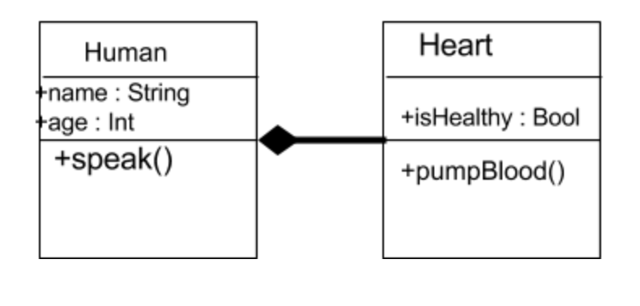

Slide 21
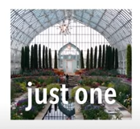
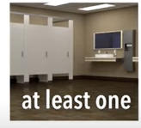
Multiplicity
Visitor Center
0..1 zero to one (optional)
n Specific number
0..* zero to many
1..* one to many
m..n specific number range
1..*
Lobby
1
Bathroom

Slide 22
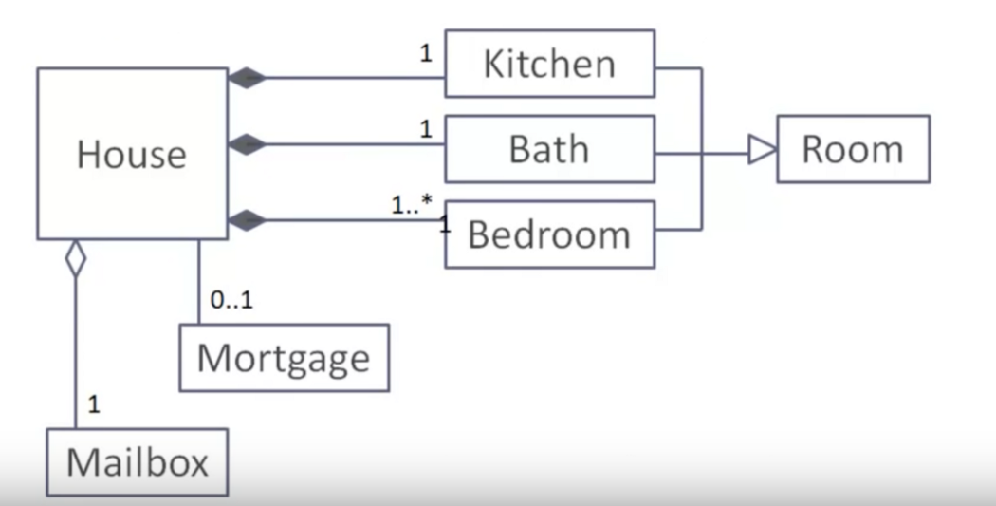

Slide 23
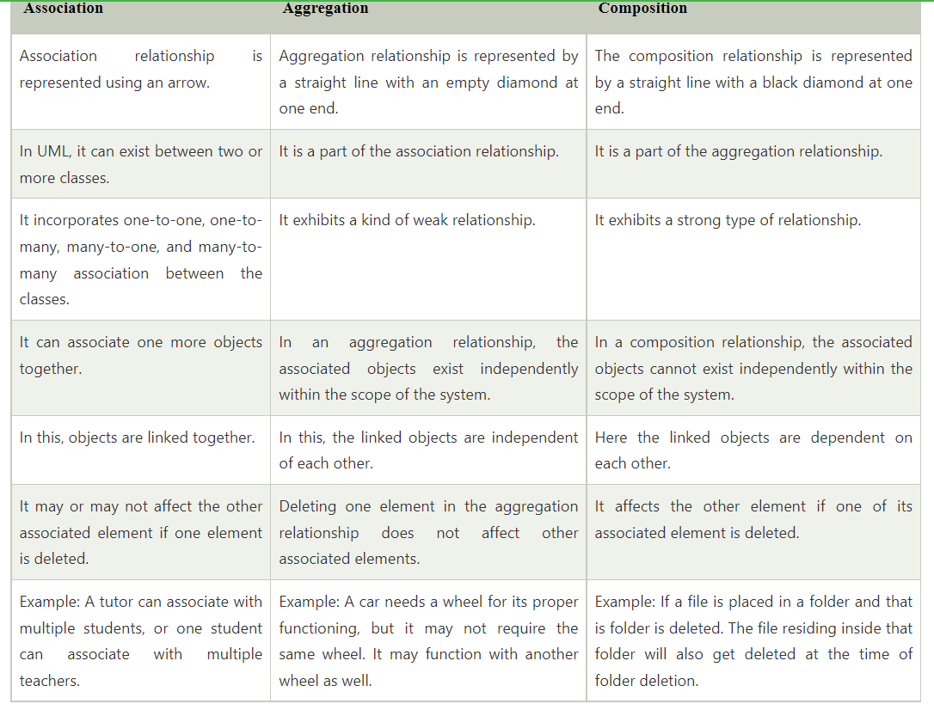

Slide 24
Use case diagram
Systems
Actors
Use cases
Relationships

Slide 25
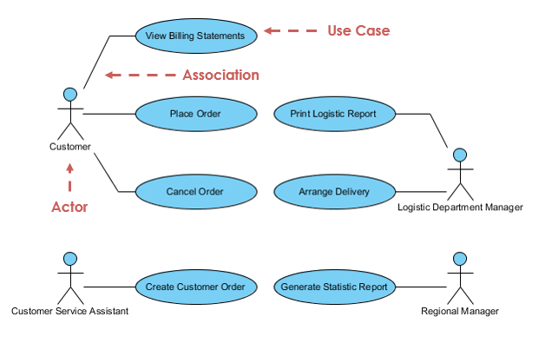
Use case diagram
A use-case model describes a system's functional requirements in terms of use cases.
It is a model of the system's intended functionality (use cases) and its environment (actors).
Use cases enable you to relate what you need from a system to how the system delivers on those needs.

Slide 26

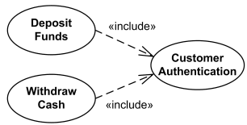

Slide 27
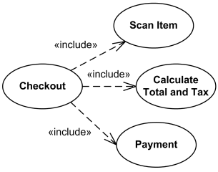

Slide 28
CLASS DIAGRAM

Slide 29
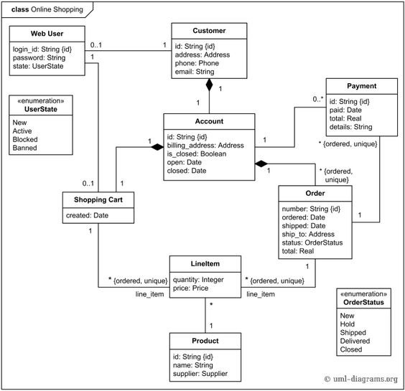

Slide 30
USE CASE DIAGRAM

Slide 31
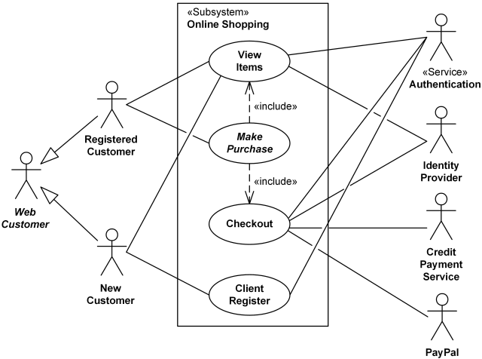

Slide 32
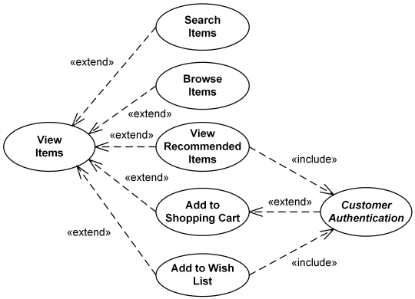

Slide 33
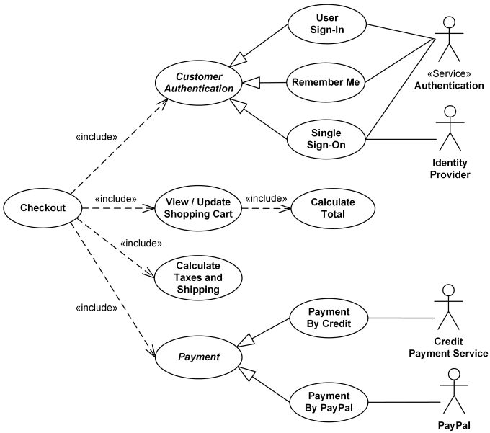

Slide 34
ACTIVITY DIAGRAM
ACTIVITY DIAGRAM is basically a flowchart to represent the flow from one activity to another activity.
The activity can be described as an operation of the system.
The basic purpose of activity diagrams is to capture the dynamic behavior of the system.
It is also called object-oriented flowchart.

Slide 35
Activity Diagram Notations
Activity diagrams symbols can be generated by using the following notations:
Initial states: The starting stage before an activity takes place is depicted as the initial state
Final states: The state which the system reaches when a specific process ends is known as a Final State
State or an activity box:
Decision box: It is a diamond shape box which represents a decision with alternate paths. It represents the flow of control.

Slide 36
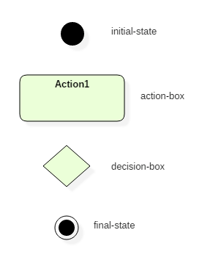
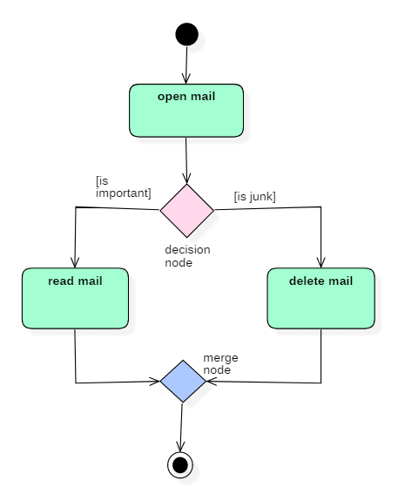

Slide 37
DEPLOYMENT DIAGRAM
Deployment Diagram is a type of diagram that specifies the physical hardware on which the software system will execute.
It also determines how the software is deployed on the underlying hardware.
It maps software pieces of a system to the device that are going to execute it.
The deployment diagram maps the software architecture created in design to the physical system architecture that executes it.
In distributed systems, it models the distribution of the software across the physical nodes.
The software systems are manifested using various artifacts, and then they are mapped to the execution environment that is going to execute the software such as nodes.
Many nodes are involved in the deployment diagram; hence, the relation between them is represented using communication paths.

Slide 38
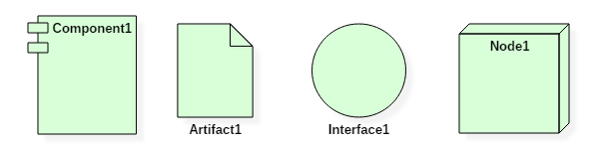
Deployment Diagram Symbol and notations

Slide 39
What is an artifact?
An artifact represents the specification of a concrete real-world entity related to software development.
You can use the artifact to describe a framework which is used during the software development process or an executable file.
Artifacts are deployed on the nodes.
The most common artifacts are as follows,
Source files
Executable files
Database tables
Scripts
DLL files
User manuals or documentation
Output files

Slide 40
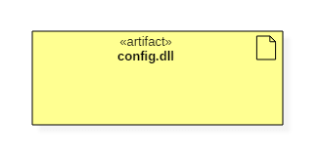
Artifacts are deployed on the nodes.
It can provide physical manifestation for any UML element.
Generally, they manifest components.
Artifacts are labeled with the stereotype <<artifact>>, and it may have an artifact icon on the top right corner.
Each artifact has a filename in its specification that indicates the physical location of the artifact. An artifact can contain another artifact.
It may be dependent on one another.
Artifacts have their properties and behavior that manipulates them.
Generally, an artifact is represented as follows in the unified modeling language.

Slide 41
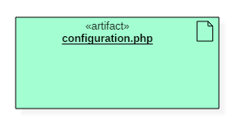
Artifact Instances
An artifact instance represents an instance of a particular artifact.
An artifact instance is denoted with same symbol as that of the artifact except that the name is underlined.
UML diagram allows this to differentiate between the original artifact and the instance.
Each physical copy or a file is an instance of a unique artifact.
Generally, an artifact instance is represented as follows in the unified modeling language.

Slide 42
What is a node?
Node is a computational resource upon which artifacts are deployed for execution. A node is a physical thing that can execute one or more artifacts. A node may vary in its size depending upon the size of the project.
Node is an essential UML element that describes the execution of code and the communication between various entities of a system. It is denoted by a 3D box with the node-name written inside of it. Nodes help to convey the hardware which is used to deploy the software.
An association between nodes represents a communication path from which information is exchanged in any direction.

Slide 43
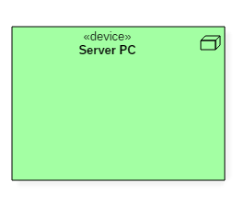
Generally, a node has two stereotypes as follows:
<< device >>It is a node that represents a physical machine capable of performing computations.
A device can be a router or a server PC.
It is represented using a node with stereotype <<device>>.
In the UML model, you can also nest one or more devices within each other.
Following is a representation of a device in UML:

Slide 44
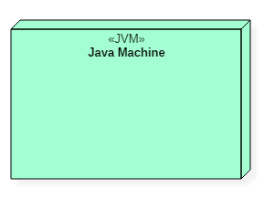
<< execution environment >>It is a node that represents an environment in which software is going to execute.
For example, Java applications are executed in java virtual machine (JVM).
JVM is considered as an execution environment for Java applications.
We can nest an execution environment into a device node.
You can net more than one execution environments in a single device node.
Following is a representation of an execution environment in UML:

Slide 45
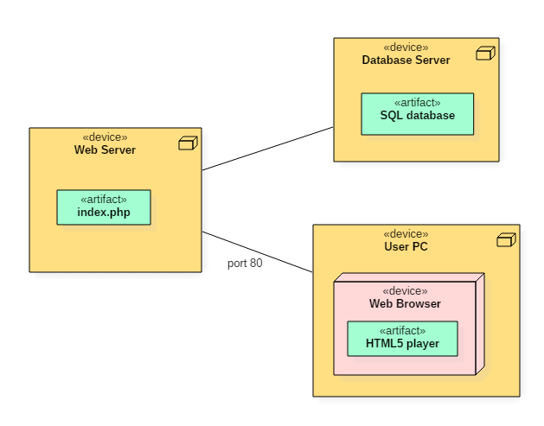
Below deployment diagram represents the working of HTML5 video player in the browser:

Slide 46
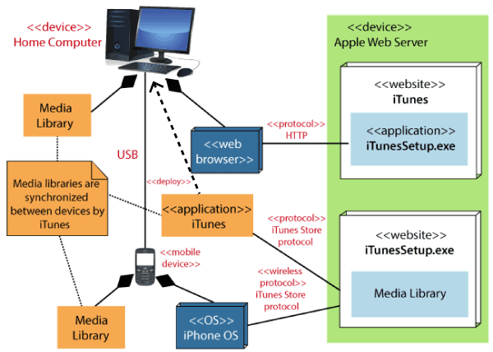
Notes:
A deployment diagram for the Apple iTunes application is given below.
The iTunes setup can be downloaded from the iTunes website, and also it can be installed on the home computer. Once the installation and the registration are done, iTunes application can easily interconnect with the Apple iTunes store. Users can purchase and download music, video, TV serials, etc. and cache it in the media library.
Devices like Apple iPod Touch and Apple iPhone can update its own media library from the computer with iTunes with the help of USB or simply by downloading media directly from the Apple iTunes store using wireless protocols, for example; Wi-Fi, 3G, or EDGE.

Slide 47
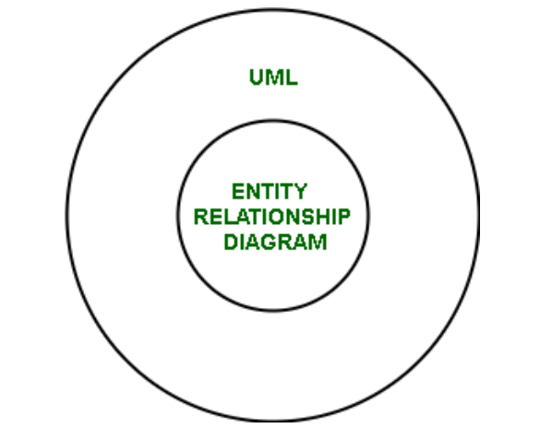
Difference between UML and ER diagram
1. Unified Modelling Language (UML) : UML is a modelling language that visually represents a software system.
2. ER Diagram : ER diagram is a pictorial representation of the real-world entities and their relationships with each other.

Slide 48
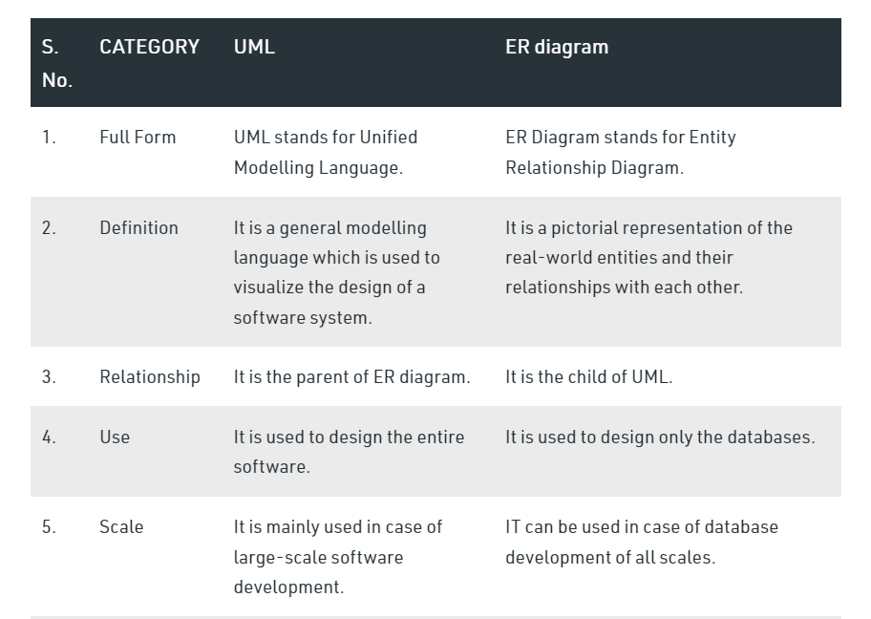

Slide 49
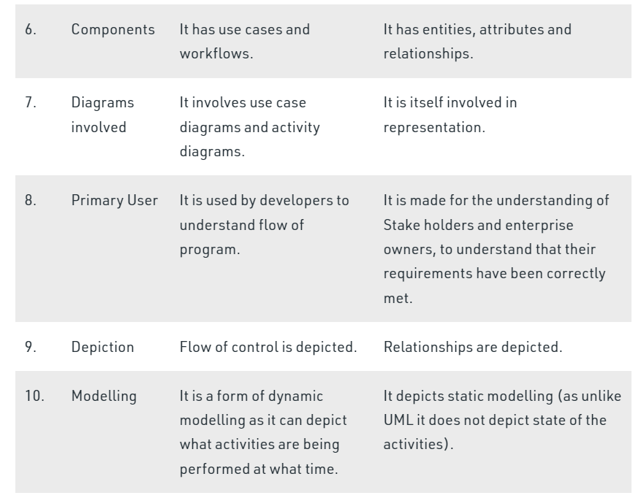

Slide 50
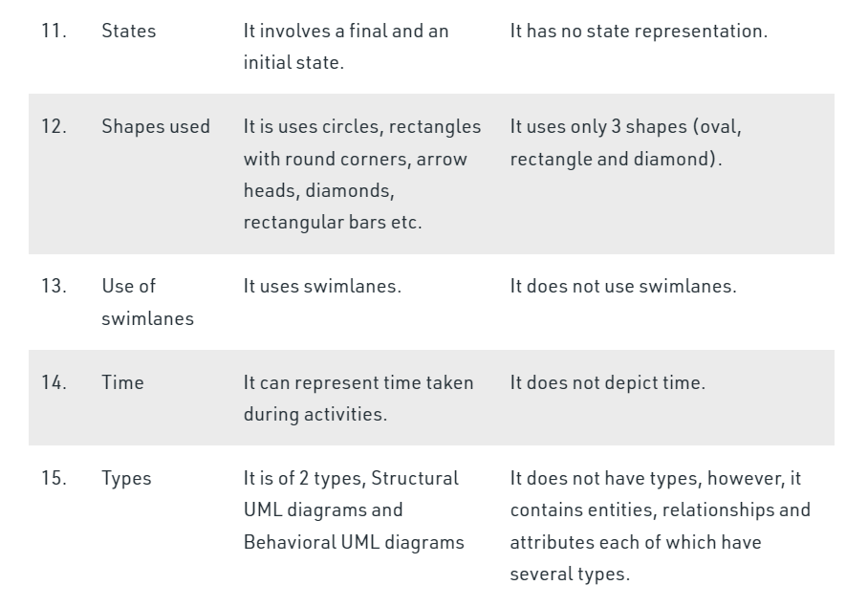

Slide 51
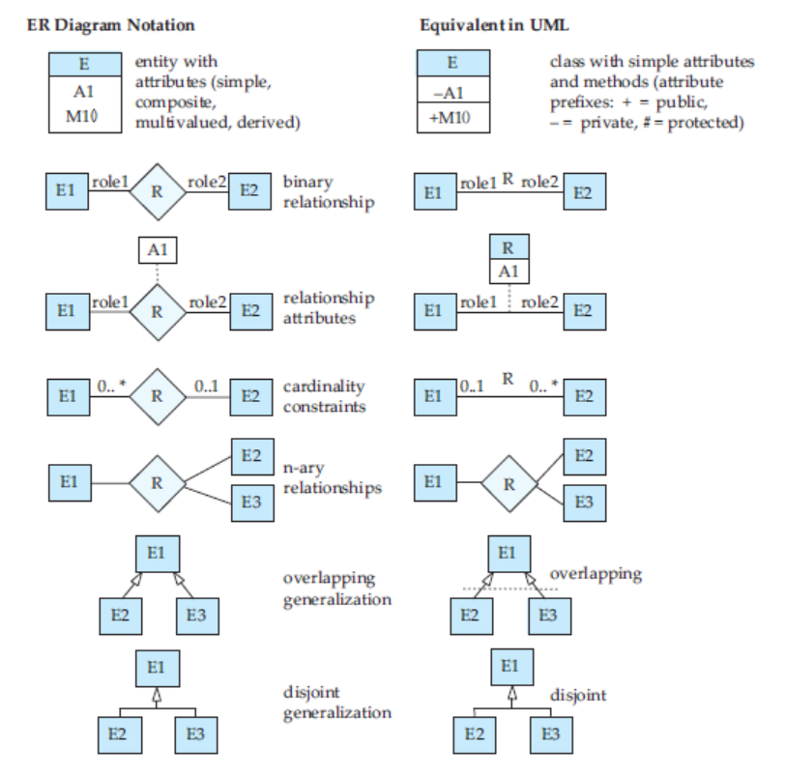

Slide 52
THANK YOU….

